Slide 1


Slide 2

CORONA PROTECTED AUTOMATIC DOORBELL
TEAM MEMBERS:
SNEHA R (927621BEC202)
SUNMATHI S (927621BEC223)
YAKSHINI M (927621BEC244)
GUIDED BY
Mrs.S.Jothimani

Slide 3
SYNOPSIS
INTRODUCTION
ABSTRACT
OBJECTIVES
WORKING
COMPONENTS
BLOCK DIAGRAM
CIRCUIT DIAGRAM
conclusion

Slide 4
INTRODUCTION
A doorbell is an indicator device typically placed near a door to a house entrance.
When touching the bell switch by different people is harmful. For good example is corona virus.
So protection from coronavirus at the entrance (doorbell switch) is necessary.
Hand sanitization is one among all good precautions.
This is designed and implemented a corona protected automatic touchless doorbell with the help of interfacing of arduino which rings automatically.
When someone wants to ring the bell he/she should show his/her hands just 3 to 5 cm. Apart in front of the mq3 sensor.

Slide 5
ABSTRACT
When someone wants to ring the bell.
He/she should put his/her hands in front of the mq3 sensor after sanitizing hands (2 to 5 cm. Distance).
At this moment mq3 generates an analog output which will drive the interfaced arduino-uno.
To generate a signal at pin-8 and pin- 9.

Slide 6
OBJECTIVES
Automatic door operators offer several advantages in addition to reducing the chances of transmitting the coronavirus.
They make it more convenient for people entering and exiting a building, particularly those carrying packages.
They reduce the risk of people getting hit by closing hinged doors or having fingers caught between a door and its frame.

Slide 7
WORKING
When someone wants to ring the bell, he/she should put his/her hands in front of the MQ3 sensor after sanitizing hands (2 to 5 cm. Distance).
At this moment mq3 generates an analog output which will drive the interfaced arduino-uno to generate a signal at pin-8 and pin- 9.
Here the led is connected to pin-8 which will glow when mq3 senses the odor of sanitizer.
Pin 9 is connected to uln2003ic which actually drives the relay at the same time and the relay is connected to the doorbell so it will ring.

Slide 8
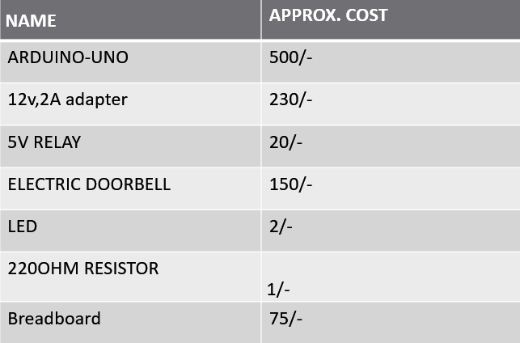
COMPONENTS

Slide 9
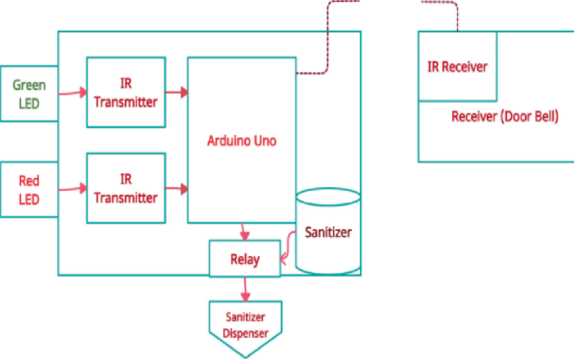
BLOCK DIAGRAM

Slide 10
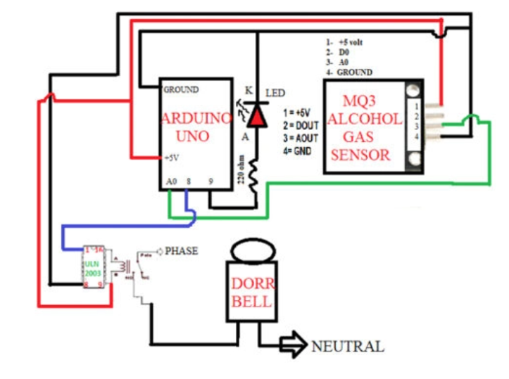
CIRCUIT DIAGRAM

Slide 11
Conclusion
Wireless doorbell functions through a transmitter that sends a coded signal when the outside button is pressed. There is a myriad of advantages of having a wireless doorbell in place of wired one.

Slide 12


